Slide 1
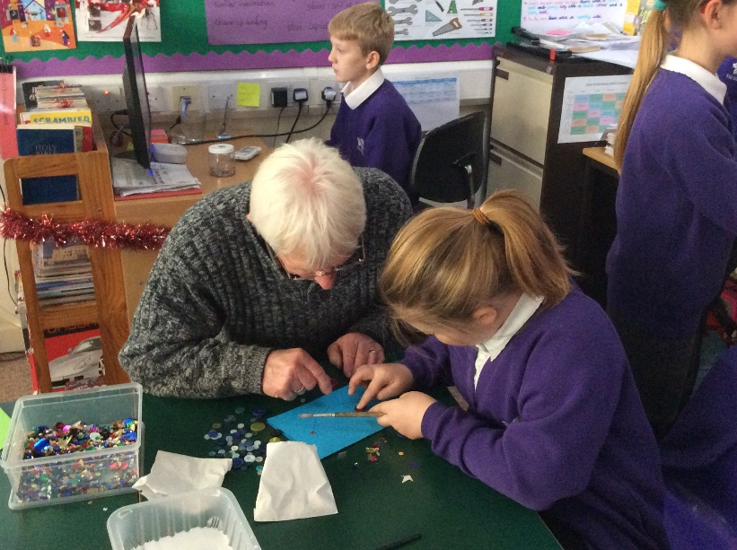
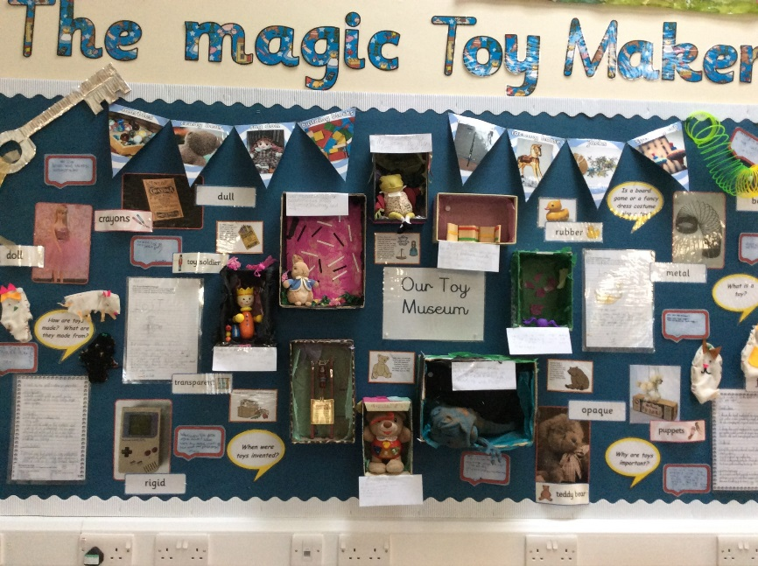
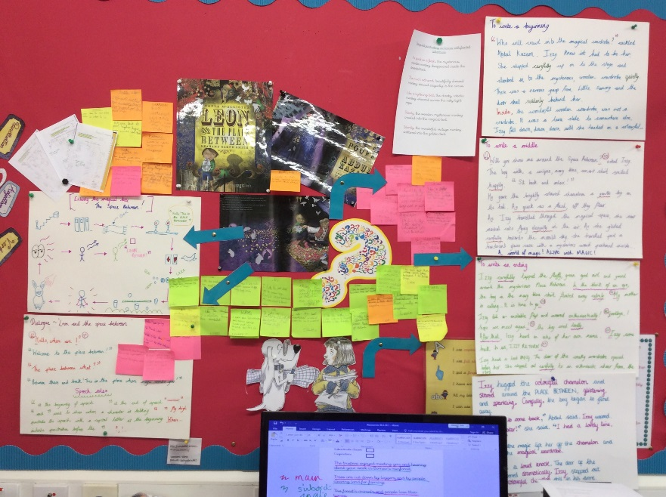
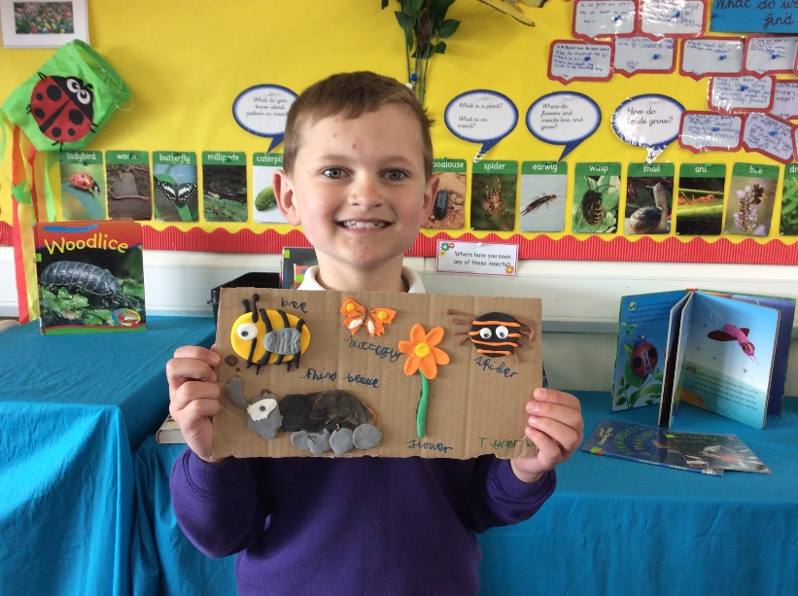
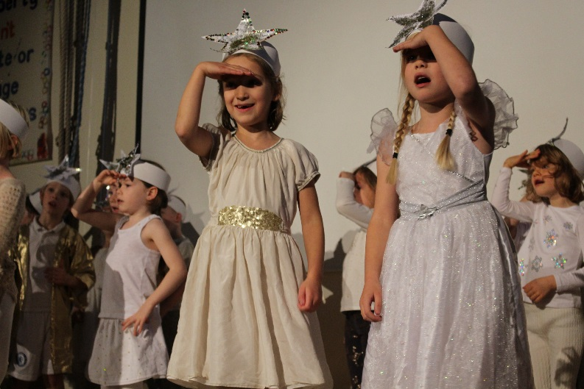
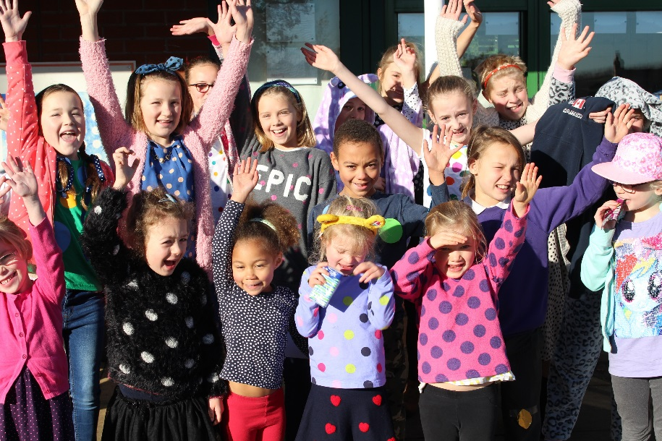
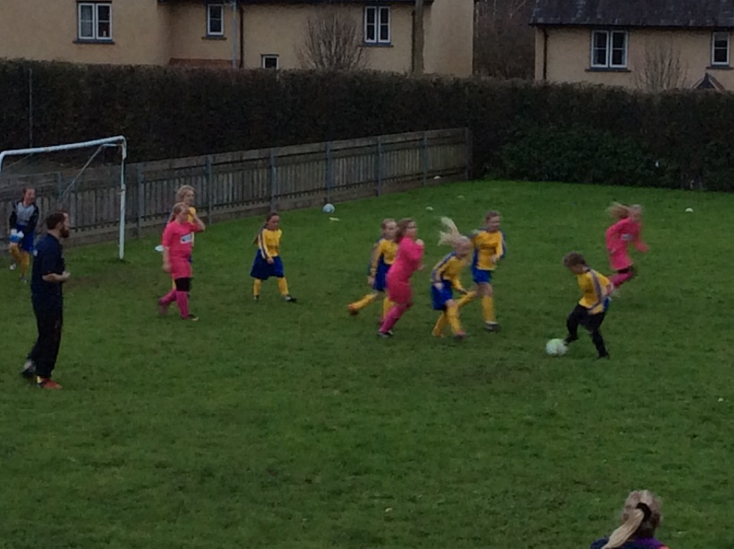
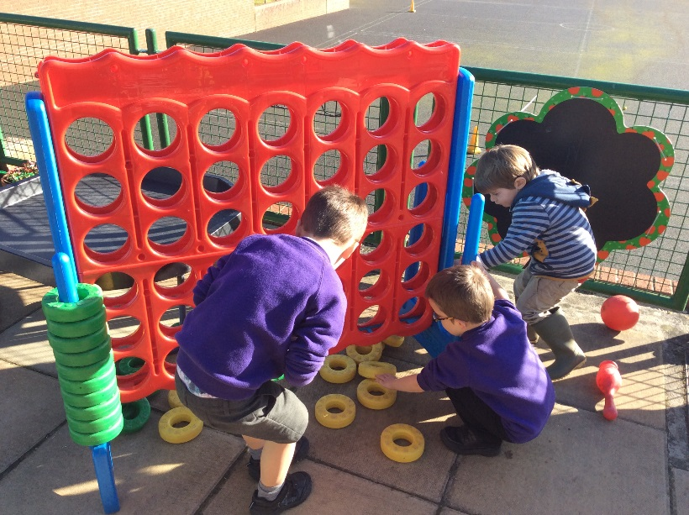
Welcome to The Duchy School!

Slide 2
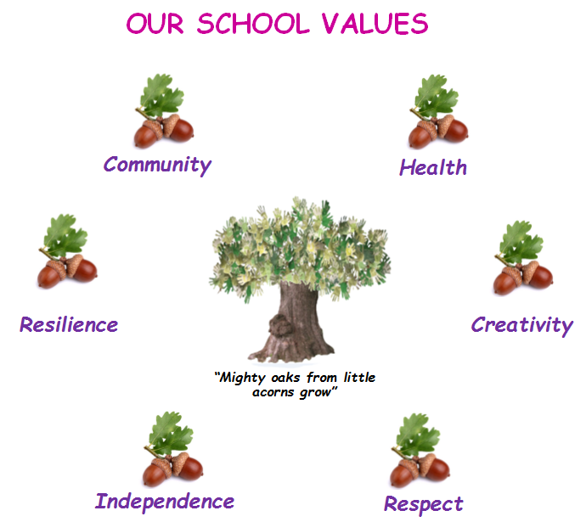
Our Vision and Values are very important to us. Hence, there is a clear understanding of why we do what we do.
Mighty oaks from little acorns grow” Our vision: Through having high expectations for all, we constantly strive to promote the overall development of all members of our school community to enable them to reach their full potential. We are a welcoming and motivational school that nurtures and supports pupils to learn transferable skills for life-long learning.

Slide 3
What are our school aims? Our school aims… To create a safe, healthy and welcoming school which values every child To ensure our children feel happy and secure within our community and play a positive role in the wider world To support children and families educationally, emotionally and socially To provide a curriculum which is stimulating and creative and inspires children to want to learn To enable children to value the diverse nature of the cultures, abilities and faiths of others whilst developing their own sense of self-worth To encourage our children to become independent and take responsibility for their own learning To equip our children with the knowledge and transferrable skills to make healthy choices now and in the future

Slide 4
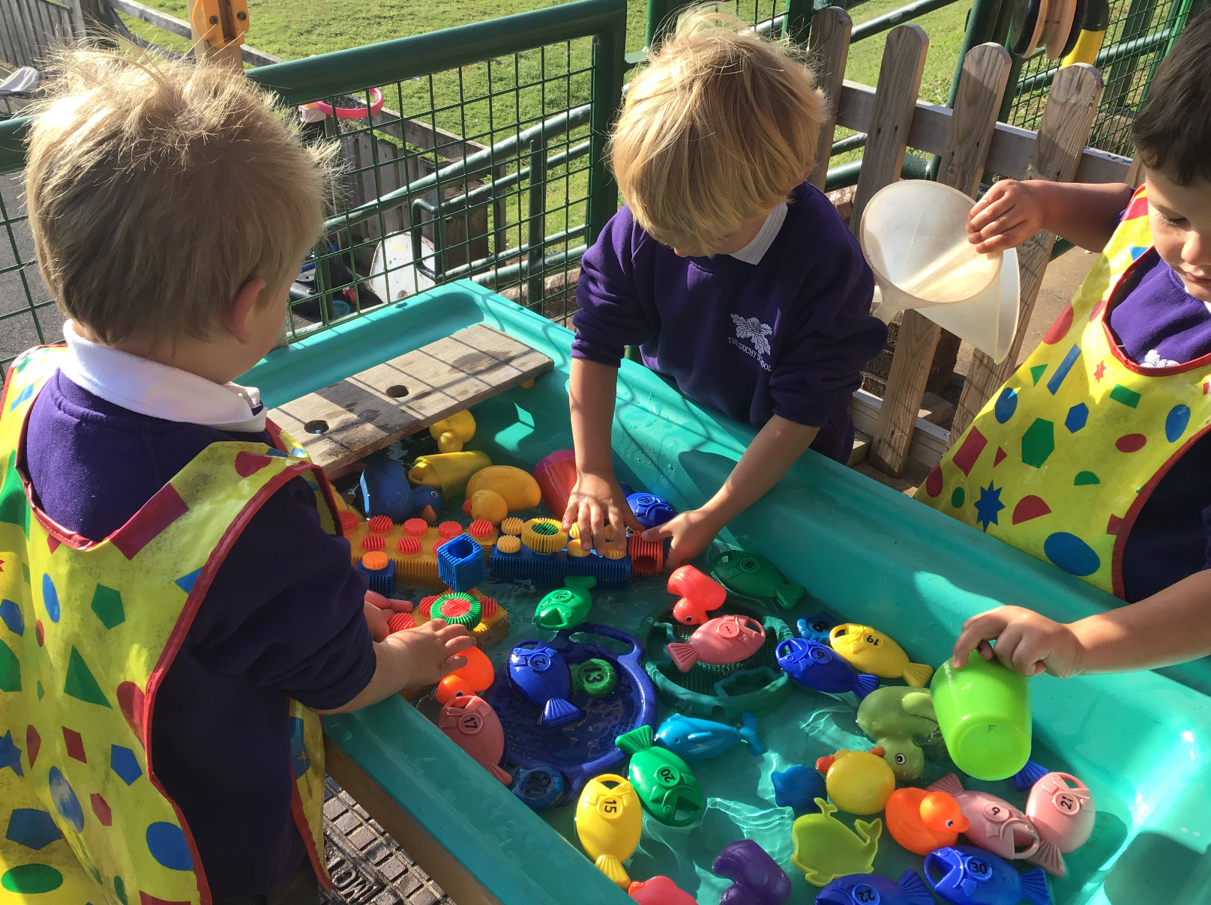
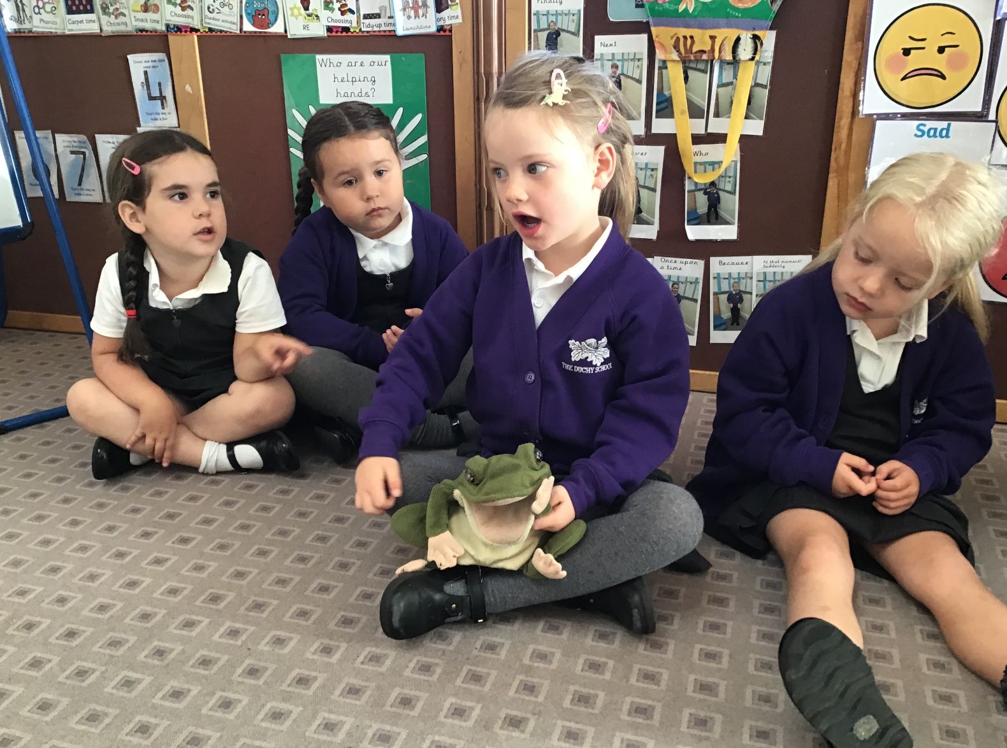
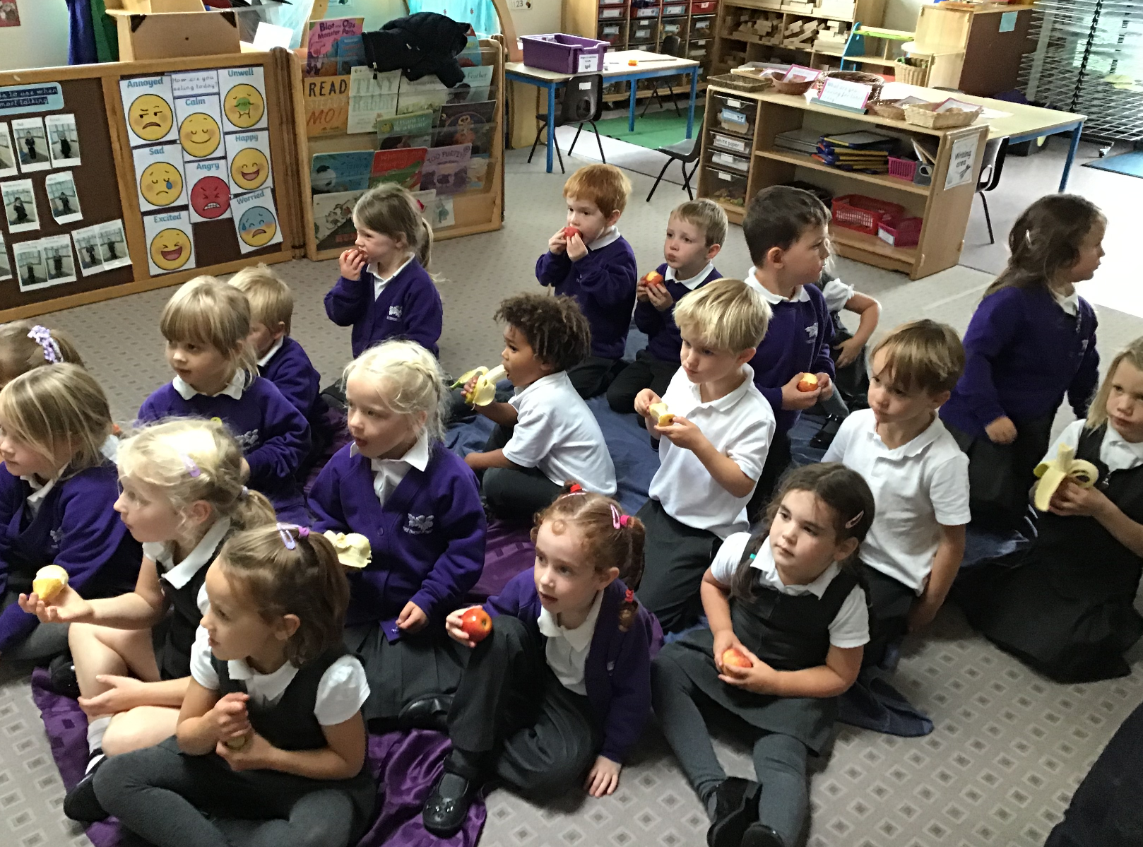
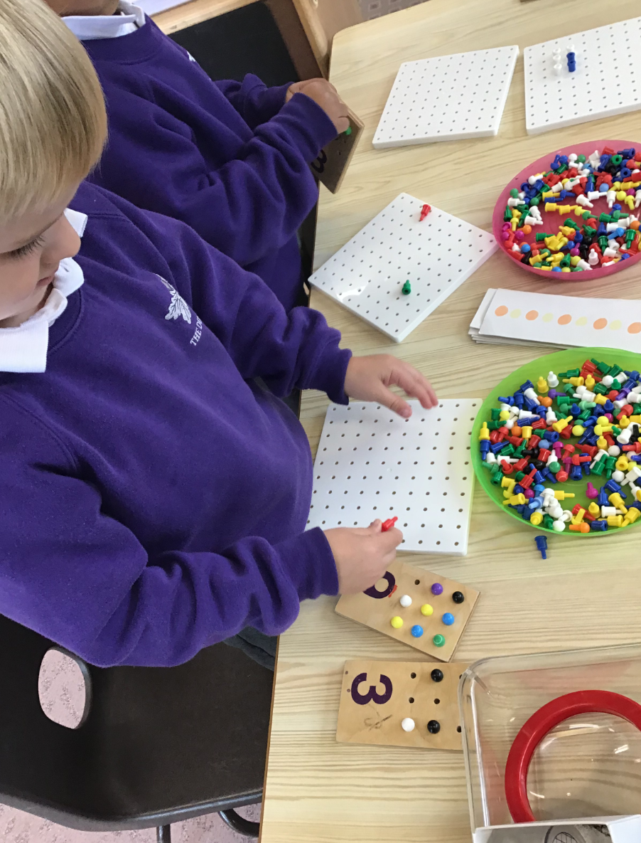
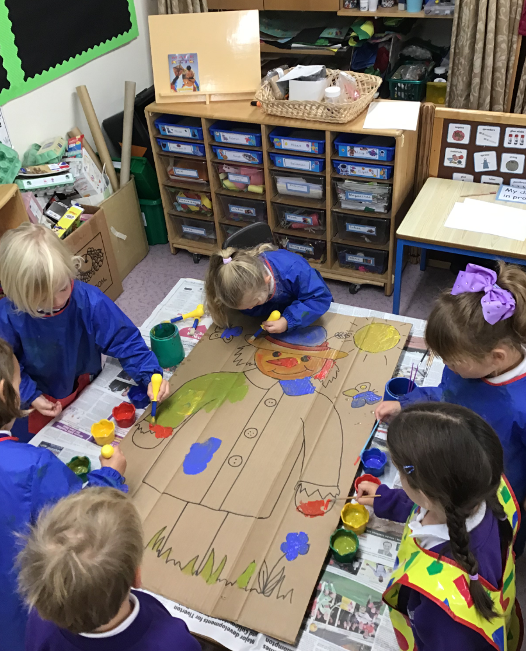
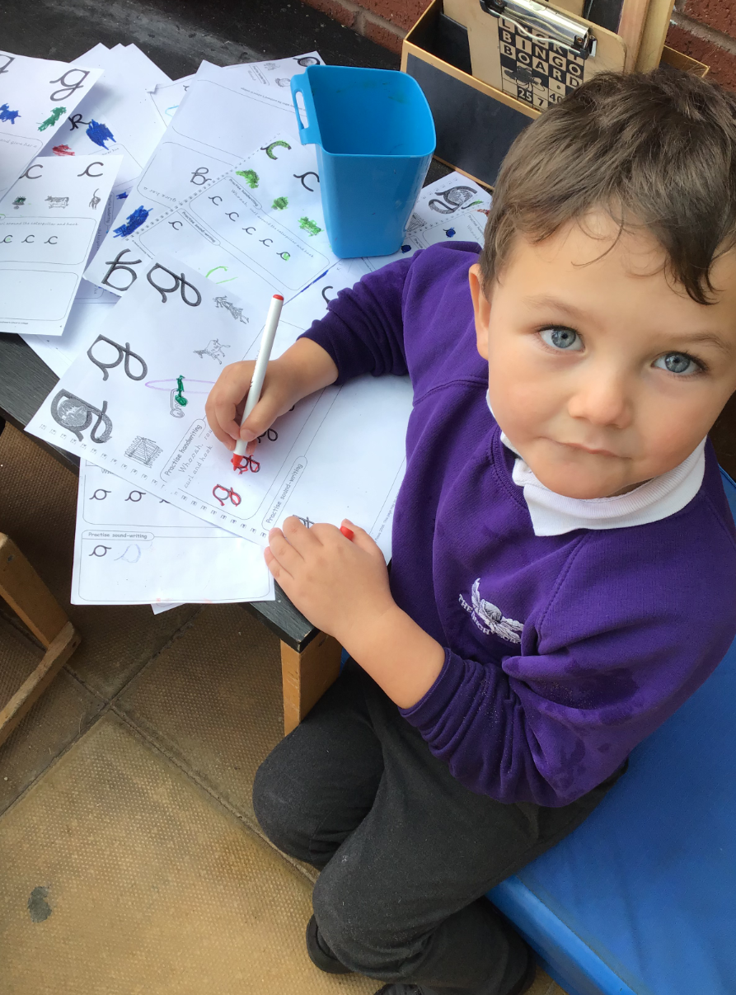
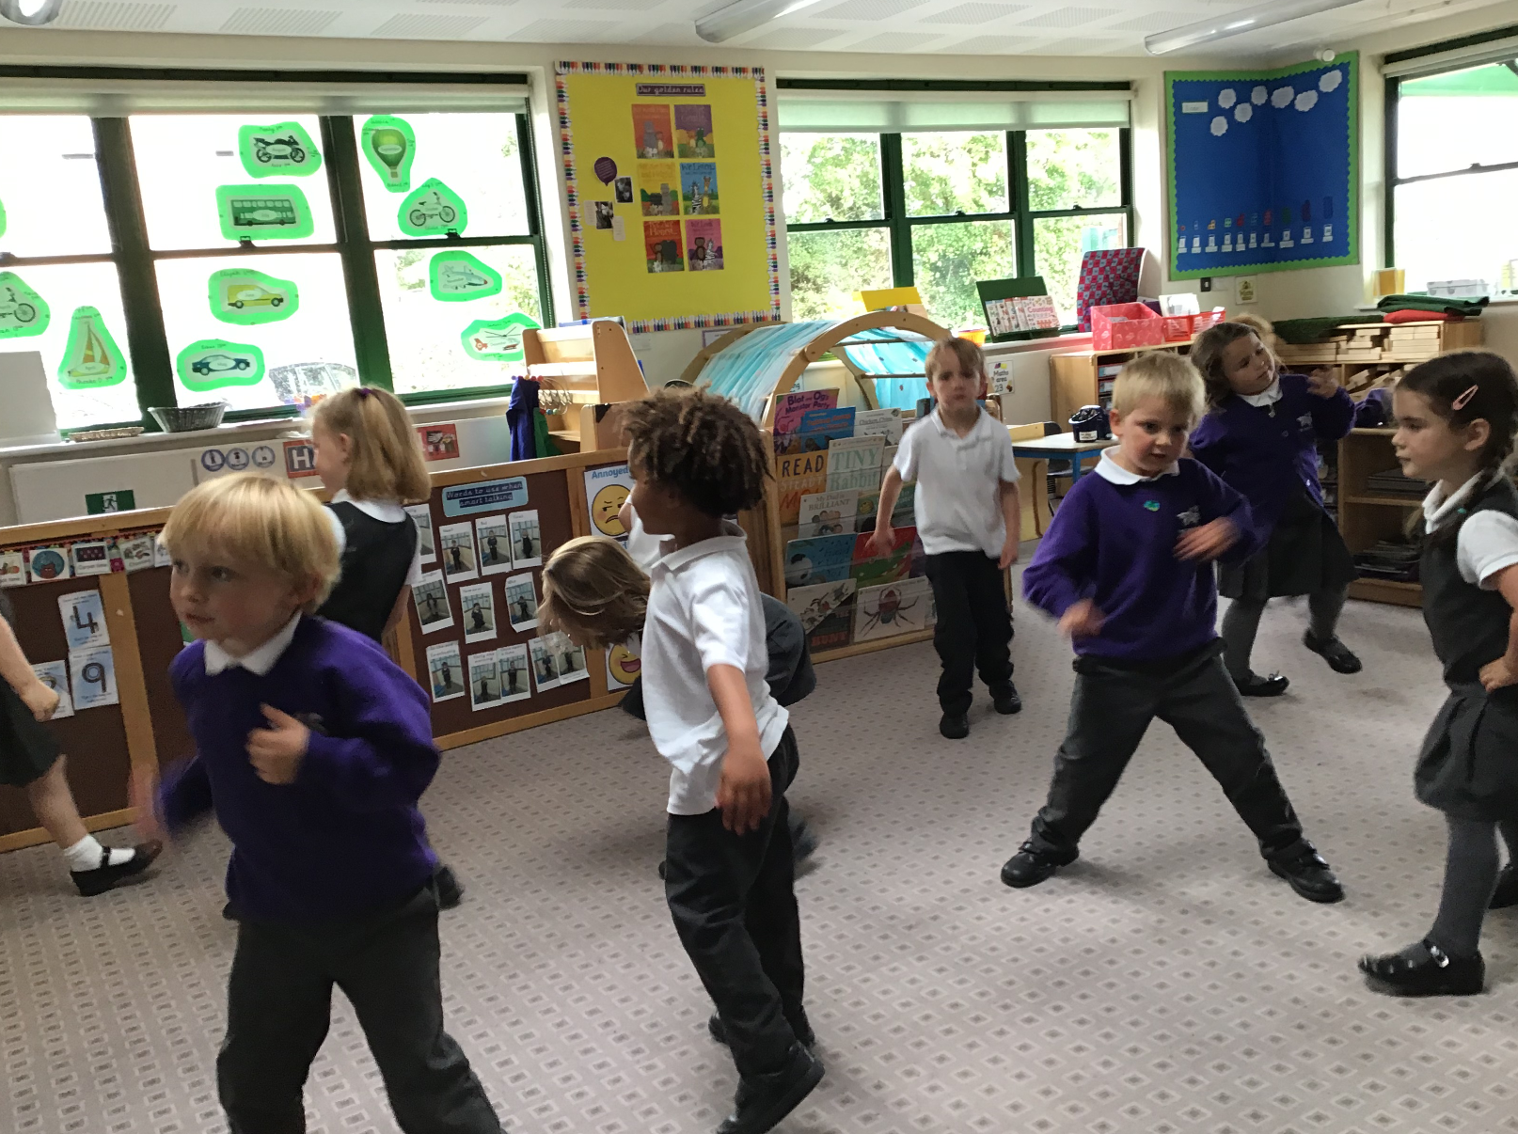
Learning Opportunities in Foundation

Slide 5
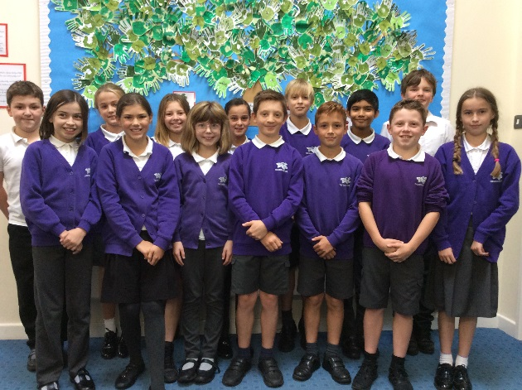
Friendship Group Captains
School Council

Slide 6
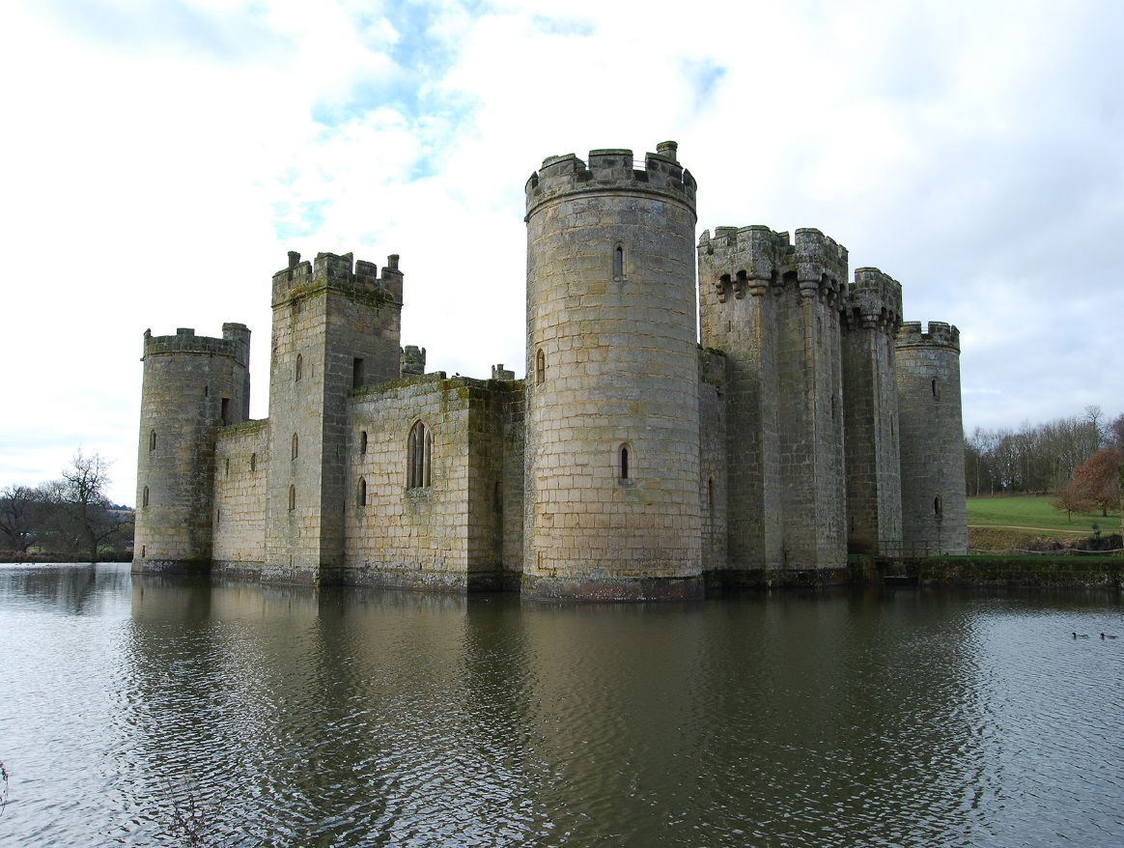
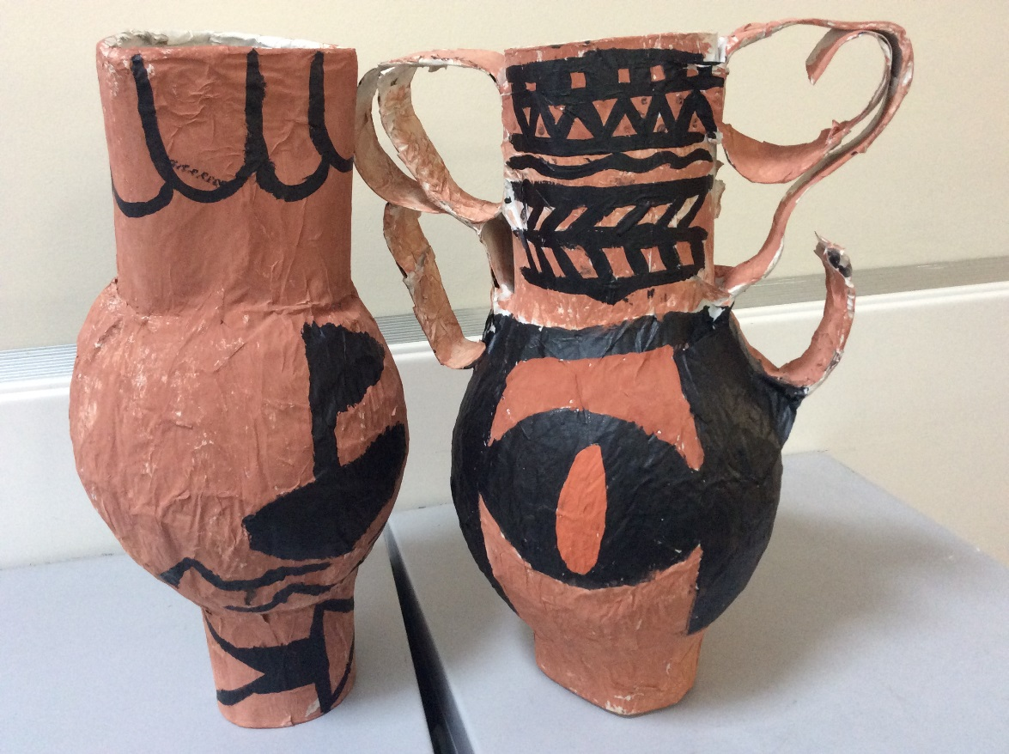
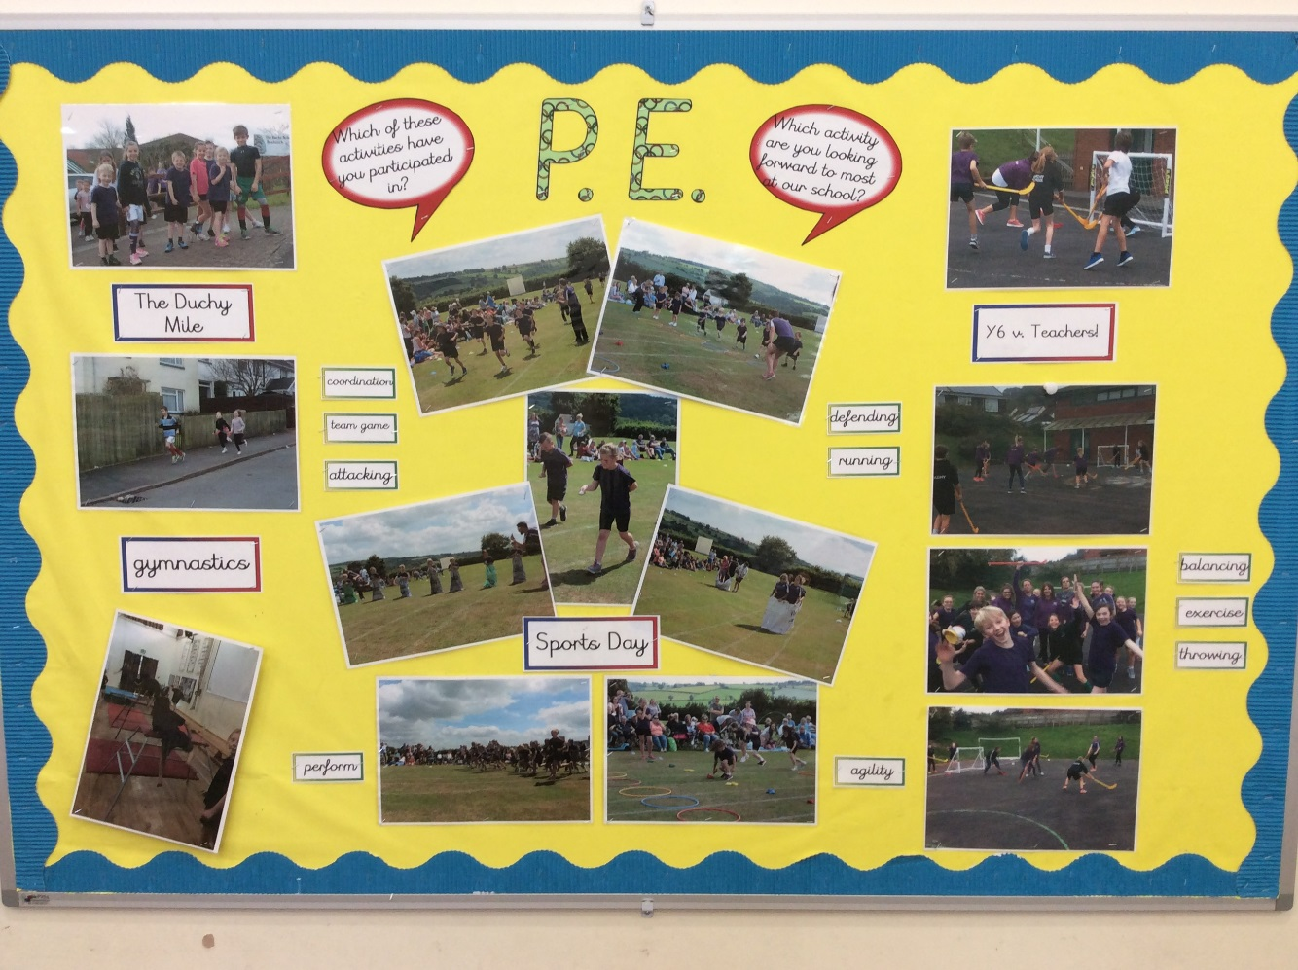
Learning is purposeful
topics to enthuse boy writers
acquired skills lead to
a quality product
skills are used to raise money and compete

Slide 7
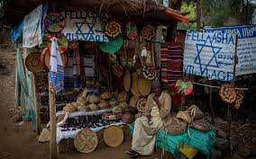
Global Link - Lelisa

Slide 8
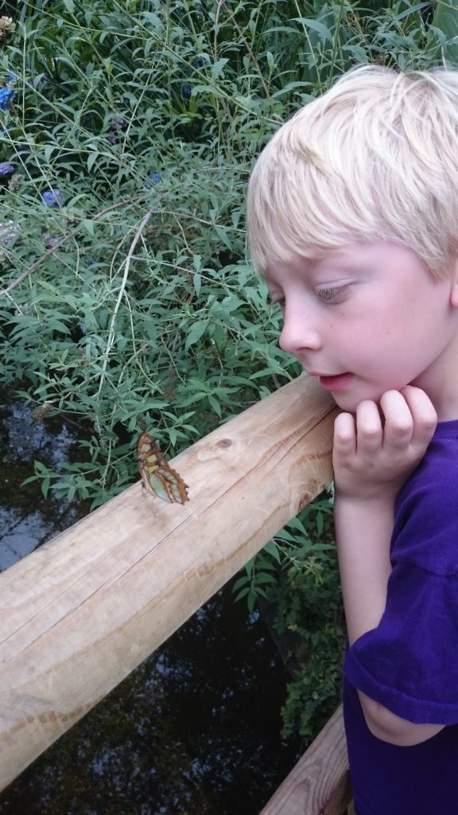
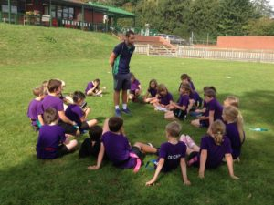
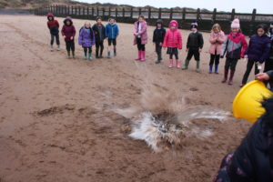
learning outside the classroom
Dawlish Warren
PE
Butterfly Farm

Slide 9
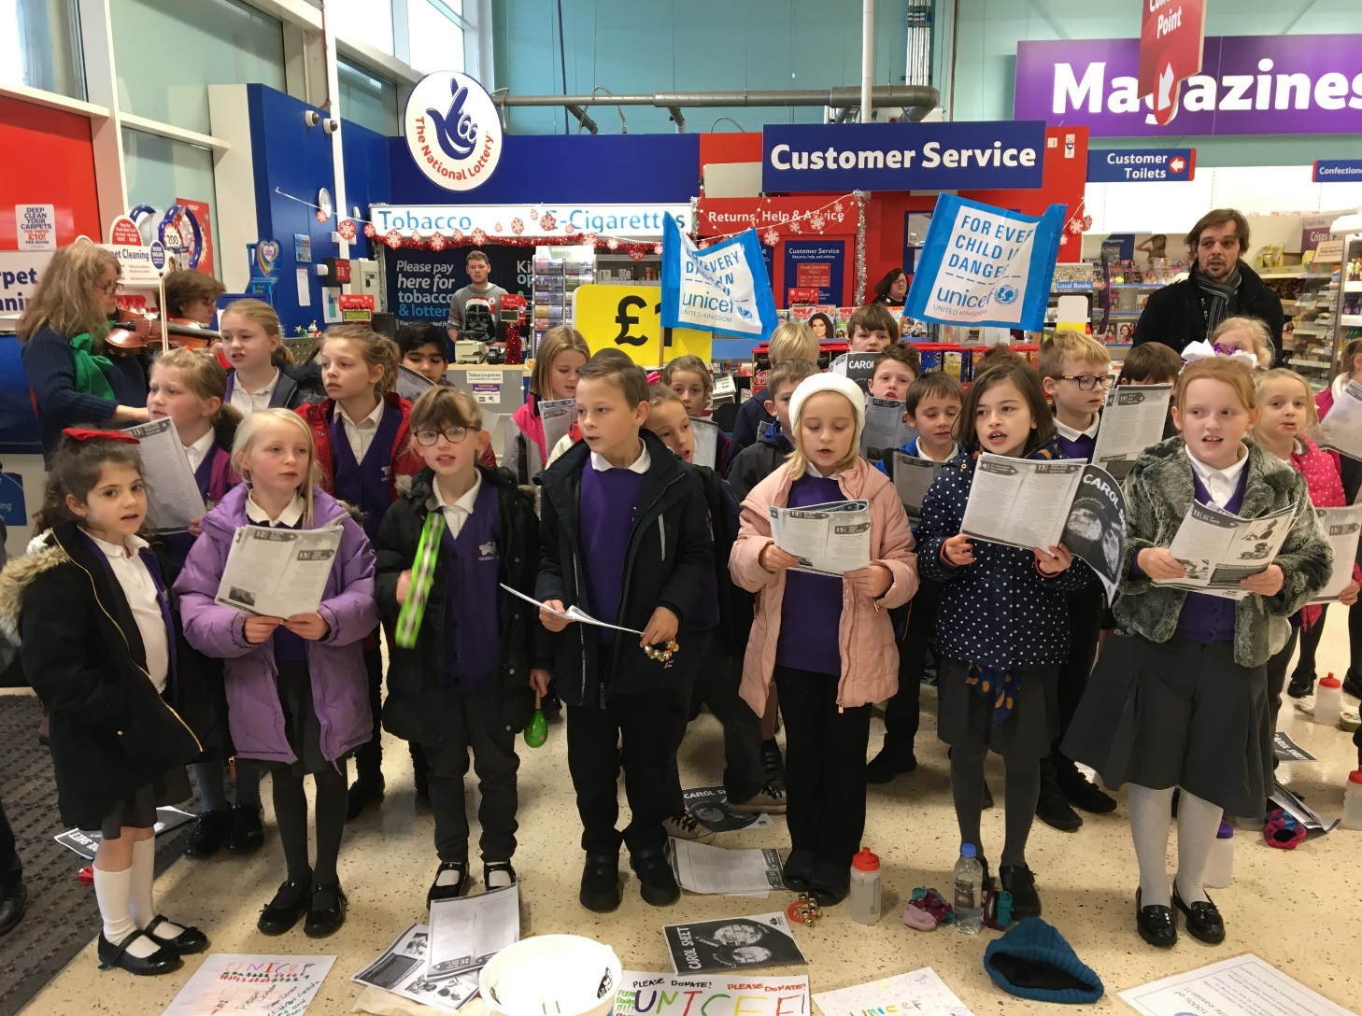
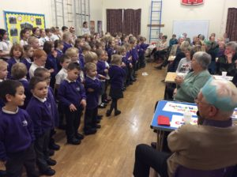
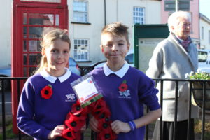
Community
Carol singing
Senior Citizens’ lunch
Remembrance Sunday

Slide 10
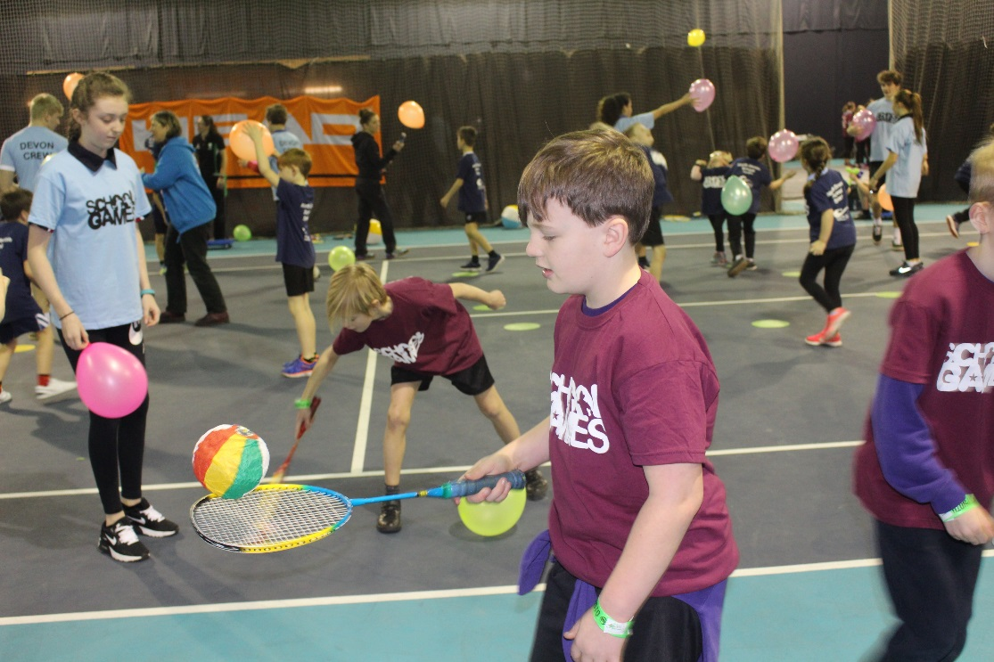
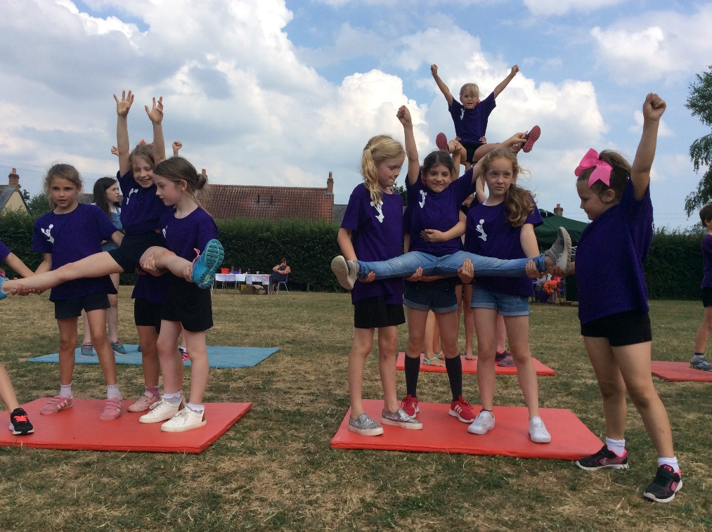
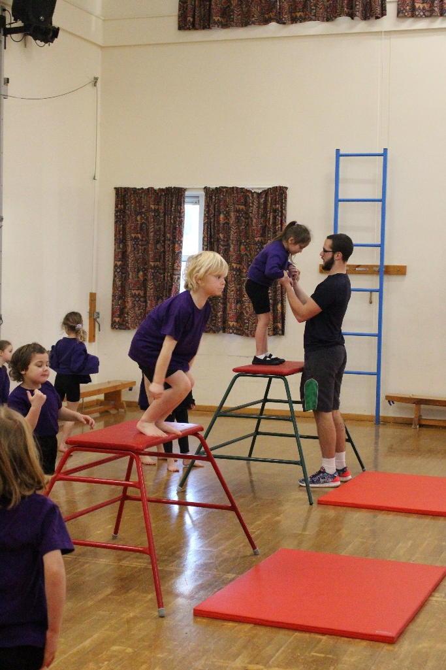
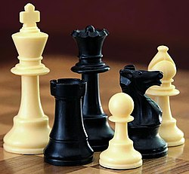
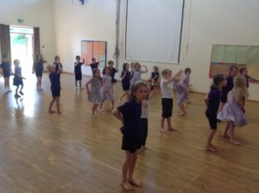
Enrichment Opportunities
Sport for All
Cheerleading
Girls’ Football
Chess
Gymnastics
Street Dance

